Slide 1
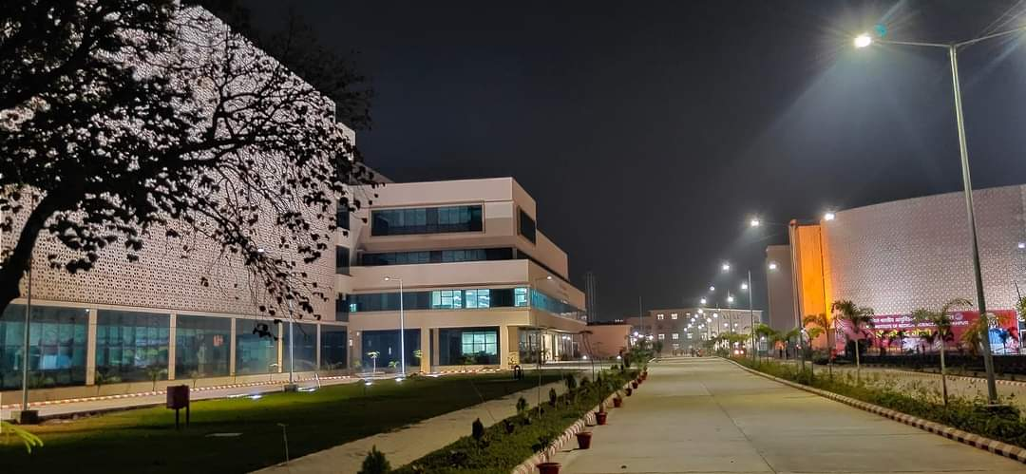
3rd Annual Conference of Cardio-Diabetic Society
All India Institute of Medical Sciences, Gorakhpur
Under the banner of
the Cardio-Diabetic Society
An International Conference on Cardio-diabetes
& Metabolic Disorders
“From care to cure”
19th -20th November 2022 | Venue: Auditorium at AIIMS, Gorakhpur
Register Now : www.accds.com

Slide 2
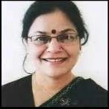
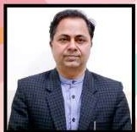
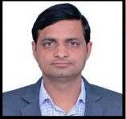
Message from Organisers
On behalf of the Cardio-Diabetic Society, we welcome you on board with us on 19th-20th November 2022 at the 3rd Annual International Conference of Cardio-Diabetic Society. This event will be organized at AIIMS Gorakhpur to have a lustful academic feast in Gorakhpur, a city in the Indian state of Uttar Pradesh, along the banks of the Rapti river in the Purvanchal region adding a blissful flavor to it. We are sure that the forthcoming conference shall bring together academics of the highest level and updated diagnostic and management protocols in advances in Diabetology and Cardiology. Academicians par excellence from India and abroad shall be present as faculty and share their ideas in the said fields. The conference will be organized in physical as well as the virtual mode to enhance participation and enrich the delegated with inputs from every nook and corner.
Hope to see you soon at AIIMS, Gorakhpur
Prof. (Dr.) Surekha Kishore
Executive Director,
AIIMS, Gorakhpur
Dr. Ravi Kant
President
Cardio-Diabetic Society
Dr. Barun Kumar
Secretary
Cardio-Diabetic Society
About Cardio Diabetic Society
The cardio-diabetic society is committed for it scientific contribution in the field of Cardiology and Diabetology, the deadly duo, globally in general and Asian countries in particular.
The society is under the patronage of top academicians and educationists. The current patron of society Prof. Surekha Kishore has been the Dean AIIMS Rishikesh and currently is the executive Director and CEO of All India Institute of Medical Sciences, Gorakhpur India.
Co-patron Prof. Ashok Kumar is currently serving as additional Medical superintendent at Post Graduate Institute of Medical Education and Research (PGIMER) Chandigarh, India. The society is functioning under young dynamic leadership of Dr.Ravi kant, Additional Professor and Head ,Division of diabetes and Metabolism at AIIMS Rishikesh ,a renowned diabetologist as president and Dr. Barun kumar, Associate Professor Cardiology at AIIMS Rishikesh , interventional cardiologist as secretary of the society. The society is relentlessly working for the preventive , promotive a curative and rehabilitative aspects of diabetes and cardiac diseases.

Slide 3
Registration Details
Registration |  | May-June | July-August | September-October | November | On Spot
For Members | Faculty | 3000 | 4500 | 6000 | 7500 | 10000
For Members | Residents/ PhD Scholars | 1000 | 1000 | 1500 | 2000 | 5000
Non Members | Faculty | 5000 | 6500 | 8000 | 9500 | 12000
Non-Members | Residents/PhD Scholars | 1000 | 2000 | 3000 | 4000 | 8000
Note: Registration fee is inclusive of 18% GST, Conference registration is mandatory for Pre-conference workshops.
Terms and Conditions:
3rd Annual Conference of Cardio-Diabetic Society will be a physical conference.
Pre-Conference Workshops on 18th November 2022 | AIIMS, Gorakhpur, UP, India
The conference is on 19th-20th November 2022 | AIIMS, Gorakhpur, UP, India
Accompanying people and children will not be allowed to attend the scientific sessions.
PG Students should submit a bonafide letter from the Head of the Department
Registration cannot be transferred.
Airport Transfers cost is not included in the registration amount
Organizers will not be responsible for any mailers or information delivery failure in case the registration form is not dully filled
Registrations Fee Includes:
Delegate:
Admission to Scientific Sessions and Exhibition
Refreshments During Breaks
Lunches
Registration Materials and Kit
Accompanying person:
Refreshments During Break
Lunch
NOTE: Please do reach out to us if any clarifications at accds@gmail.com

Slide 4
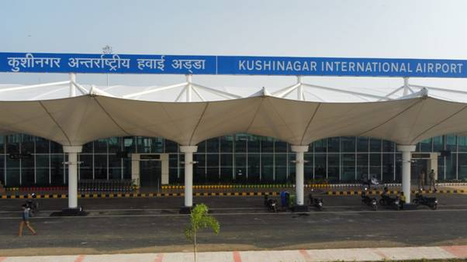
How to reach Gorakhpur
Gorakhpur railway station
Gorakhpur airport
Kushinagar airport

Slide 5
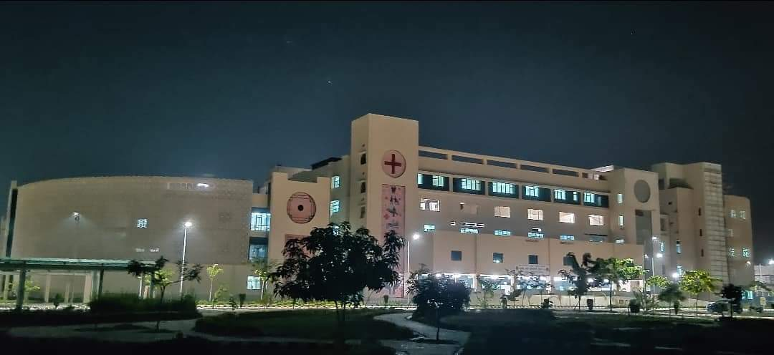
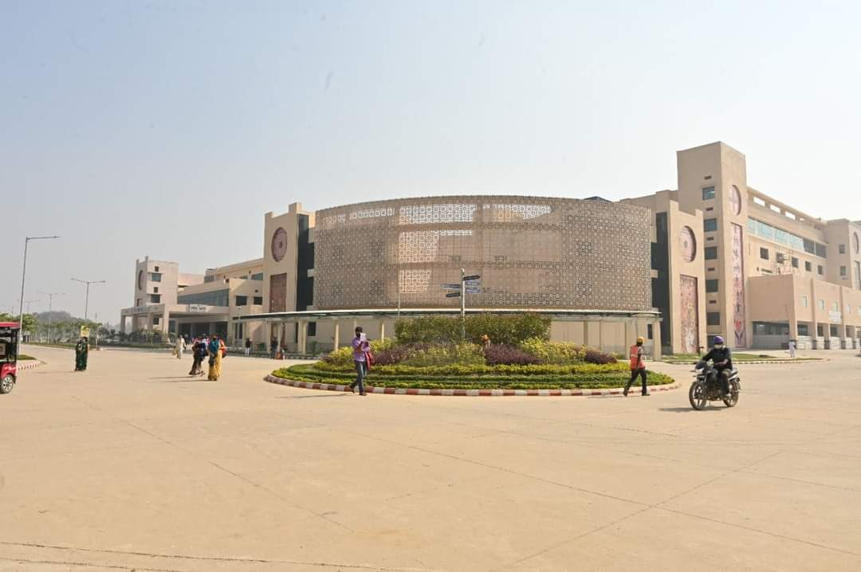
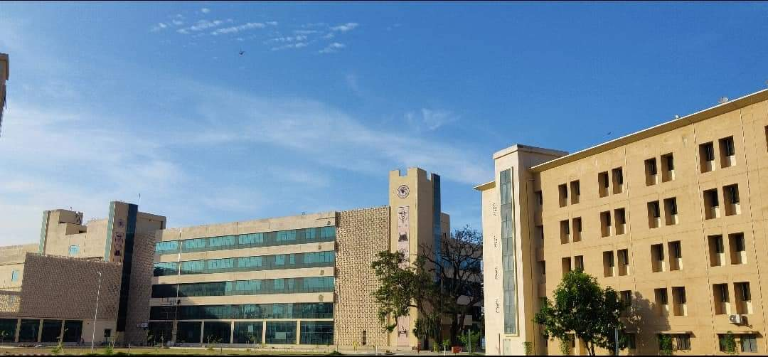
About Gorakhpur
About AIIMS, Gorakhpur
AIIMS, Gorakhpur is one of the new AIIMS established as a part of the initiative under Pradhan Mantri Swasthya Suraksha Yojna (PMSSY) by the Ministry of Health and family welfare, Govt. of India.
This institute has been established with the aim of correcting regional imbalances in quality tertiary level healthcare in the country and attaining self-sufficiency in graduate and postgraduate medical education and training.
AIIMS, Gorakhpur is imparting medical education in all branches of medical science and related field, along with nursing and paramedical training to bring together in one place, educational facilities of the highest order for the training of personnel in all branches of health care activities.
Gorakhpur belongs to the Great Lord Buddha, founder of Buddhism, who renounced his princely costumes at the confluence of rivers Rapti & Rohini and proceeded further in the quest of truth in 600 BC.
It is also associated with Lord Mahavir, 24th tirthankar, founder of Jainism.
It is the birthplace of Gorakhnath. His samadhi at Gorakhpur attracts a large number of pilgrims every year.
The most significant event in the medieval period, however, was the coming of mystic poet and famous saint Kabir to Maghar. It was here that he gave the message to his countrymen to live in peace and religious harmony. The co-existence of 'Samadhi' and 'Makbara' at his burial place in Maghar attracts a large number of followers.
Gorakhpur is also identified with the Gita Press, the world famous publisher of the Hindu religious books. The Gita Press is fore-front in dissemination of religious and spiritual consciousness across the country.
Gorakhpur rose to great eminence due to the historic 'CHAURJCHAURA' incident of 4th Feb.,1922, which was a turning -point in the history of India's freedom struggle.

Slide 6
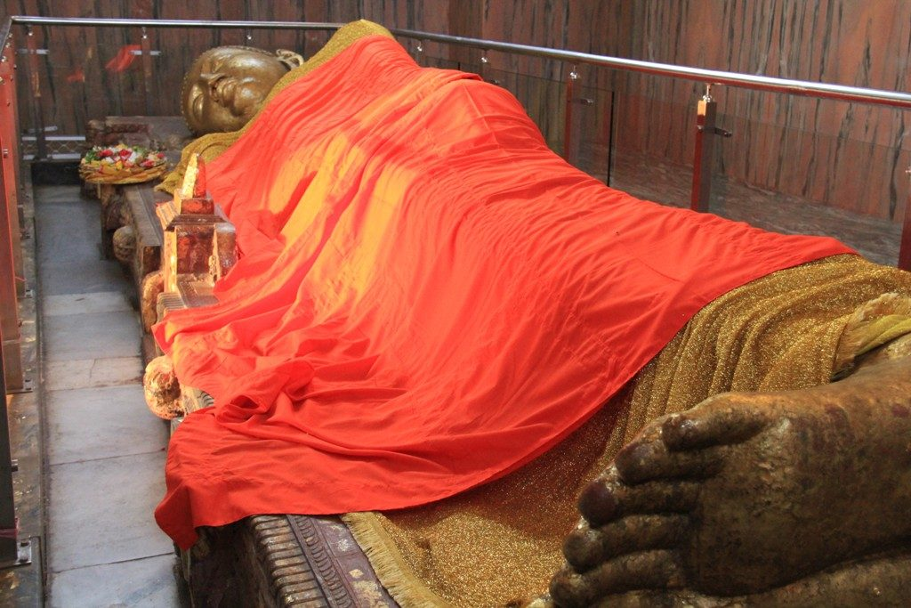
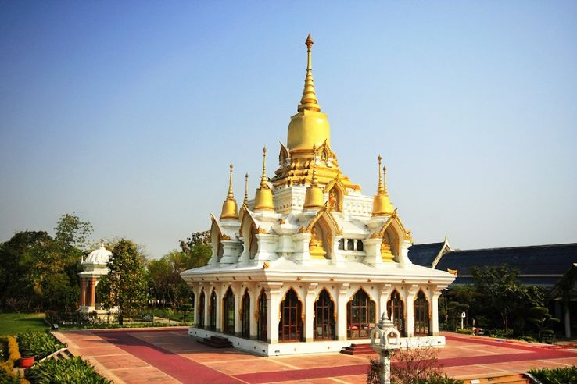
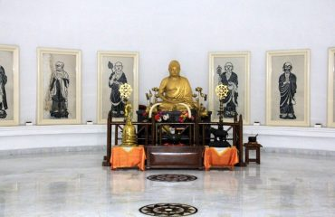
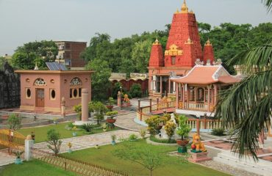
Gorakhpur Nearby Attractions
Kushinagar

Slide 7
3rd Annual Conference of Cardio-Diabetic Society
Oral Presentation
Rules for abstract submission
The abstract must not exceed 250 words and should be in 12pt Arial font with double spacing.
The title of the abstract must be concise, avoid using abbreviations.
Do not include the personal details (Presenting Author, Co-Author, Institute, or Hospital Name in Abstract).
Postgraduate students presenting paper need to submit a letter from the Head of the Department.
Any paper submitted by the Post Graduate student should be certified by His / Her mentor.
Abstract should be in IMRAD format.
Do not include Images, Graphs or Tables in the abstract.
The first author will be considered as the presenting author
One author can present only one oral presentation or one Poster presentation
Last date for submitting the abstract is 30th Septemper 2022
The scientific committee reserves the right to accept/reject any paper without assigning any reason thereof.
Conference registration is mandatory to present Free Paper / Poster.
NOTE: The Committee reserves the right to: Select abstract relevant to the scientific program. Decide on the final form of presentation (Oral or Poster)
Colour Suggestions:
When using light backgrounds (white, yellow, light blue) we suggest using dark fonts (black, navy blue, dark green).
When using dark backgrounds (blue, purple) we suggest using light fonts (white, yellow, cyan).
Avoid using red or green in any fonts or backgrounds as they are colors that are difficult to read.
Illustrations/images/photographs used in the poster should be enlarged enough to show relevant details.

Slide 8
3rd Annual Conference of Cardio-Diabetic Society
Poster Presentation
Rules for the abstract submission
The abstract must not exceed 250 words and should be in 12pt Arial font with double spacing.
The title of the abstract must be concise, avoid using abbreviations
Do not include the personal details (Presenting Author, Co-Author, Institute, or Hospital Name in Abstract).
Postgraduate students presenting paper need to submit a letter from the Head of the Department.
Any paper submitted by the Post Graduate student should be certified by His / Her mentor.
Case study presentation must include Introduction, Aim & Objectives, Background, Case, Conclusion/ Clinical Relevance.
Case report presentation must include Introduction, Aim & Objectives, Materials & Methods, Results, Conclusion.
Do not include Images, Graphs or Tables in the abstract.
The first author will be considered as the presenting author.
One author can present only one poster.
Last date for submitting the abstract is 30th Septemper 2022
The scientific committee reserves the right to accept/reject any paper without assigning any reason thereof.
Conference registration is mandatory to present Free Paper / Poster.
The poster should be self-explanatory. Text should be brief and well organized.
NOTE: The Committee reserves the right to: Select posters relevant to the scientific program. Decide on the final form of presentation (Oral or Poster)
Colour Suggestions:
When using light backgrounds (white, yellow, light blue) we suggest using dark fonts (black, navy blue, dark green).
When using dark backgrounds (blue, purple) we suggest using light fonts (white, yellow, cyan).
Avoid using red or green in any fonts or backgrounds as they are colours that are difficult to read.
Illustrations/images/photographs used in the poster should be enlarged enough to show relevant details.

